Slide 1

Adventure
Works
HARIOM CHAUDHARY

Slide 2

INTRODUCTION
This project aims to analyze the Adventure Works dataset, provided by Microsoft, to uncover key insights, trends and patterns in customer behavior, sales performance, product profitability and overall growth.
Through data visualization, statistical analytics and data mining techniques, we will explore the dataset to answer business questions, identify areas for improvement and provide data driven recommendations for strategic decision making.

Slide 3
OBJECTIVES
Identify Key Performance Indicators
Discover top performing products
Calculate country wise sales & profit
Improve customer experience
Appraise overall sales performance
Evaluate YoY growth
Analyze customer behavior and market trends.

Slide 4
DATA OVERVIEW
Adventure Works dataset features sales data, customer details, sales territory and product details.
PROCESS INVOLVED-
Data cleaning
Identifying important columns
Treating nulls and missing values
Data modelling (connecting tables)
Identifying Key Value Indicators
Analyzing and creating calculated measures/columns
Visualizing the data

Slide 5
TOOLS USED
SQL to fetch data from the databases.
Power query editor to transform the data.
Excel & Power BI to analyze the initial patterns and identify the key performance indicators.
Power BI Dax to make calculated measures/columns.
Power BI for visualizing and dashboarding.

Slide 6

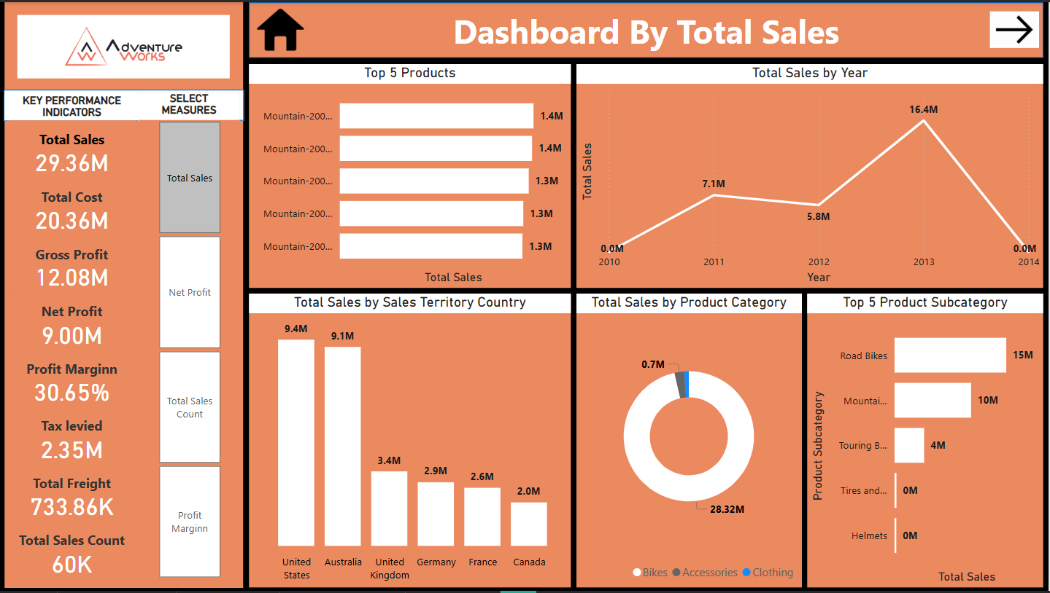

FEATURES USED
KPIs Parameters Drill down Drill through Dax Bar graph Column chart Donut chart Line chart

Slide 7
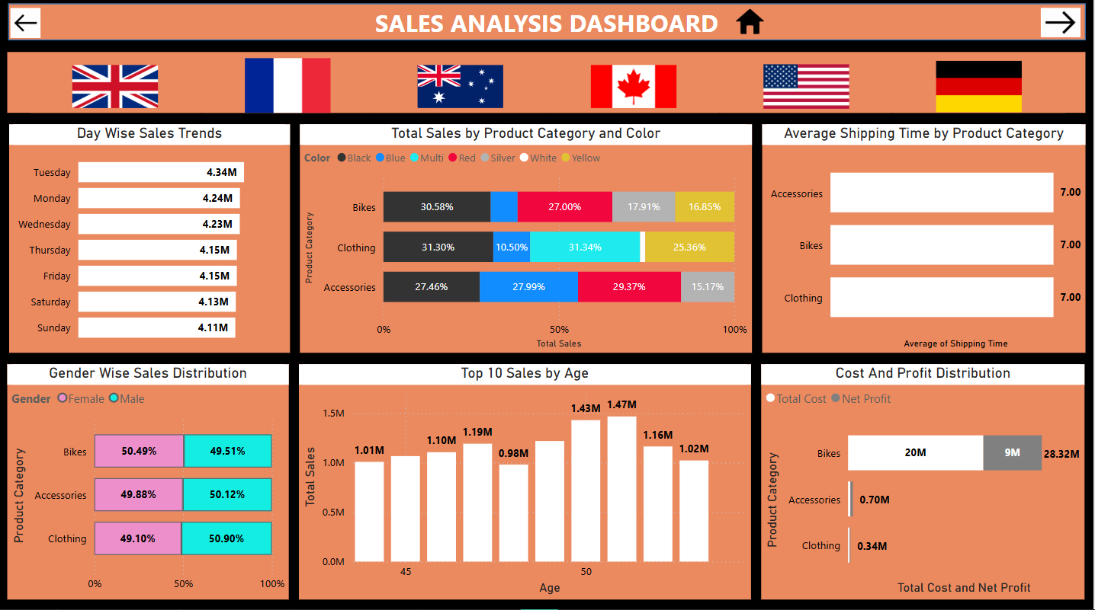
FEATURES USED
Image slicer Drill down Drill through Dax Bar graph Column chart

Slide 8
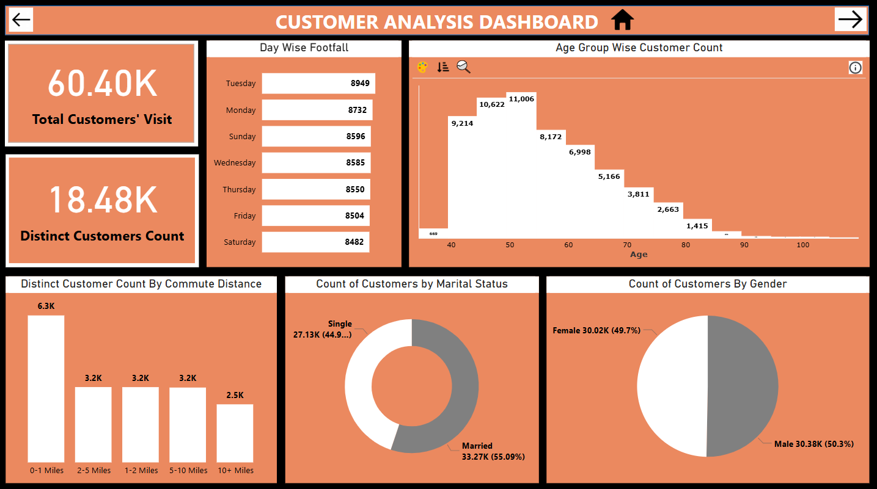
FEATURES USED
Histogram (custom chart) Drill down Drill through Dax Bar graph Column chart Donut chart Pie chart

Slide 9
INSIGHTS
Canada and European countries are having less sales revenue compared to United States and Australia.
Accessories and clothing categories are having negligible sales revenue despite having a huge share in sales volume.
Profit margin for accessories is highest among all the categories, amounts to approx. 52%.
Accessories are having approx. 60% of share is sales volume and profit margin is also more than 50% which is a good sign.
Most of the customers belong to 40-54 years of age. Elderly people are very less in numbers.
Unmarried customers are lesser than married customers.
Gender wise customer distribution is 50-50 which shows male and female are equally purchasing the products.
Customers living closer (within 0-1 Miles of distance) to the store are visiting more.

Slide 10
RECOMMENDATIONS
Need to increase the footprints in Europe and Canada.
Elderly friendly bike can be launched to tap the elderly customers segment.
To attract unmarried customers, we can organize some events where they can meet new people.
Door step delivery can solve the problem of commutation for customers living far.
New branches can be opened in different areas in the longer run that people don't need to commute far.

Slide 11
SUMMARY
This project is about Adventure Works dataset, analyzing which I learnt how to analyze sales data and collect insightful trends and patterns which can lead to the data driven decision making.
I got the hands-on practice of tools like Advance Excel, power query editor, pivot table, data modelling, Power BI, Dax, drill down, drill through, SQL etc.
I learnt how to perform data cleaning, treating null values and handling blanks, merging tables, analyzing data, identifying important columns and key performance indicators, visualizing the data and dashboarding.
I would like to further contribute to the data driven industry and unravel the hidden patterns and trends that it can become the growth engine for the company.

Slide 12
THANK you

